Slide 1
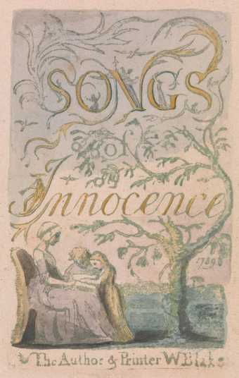
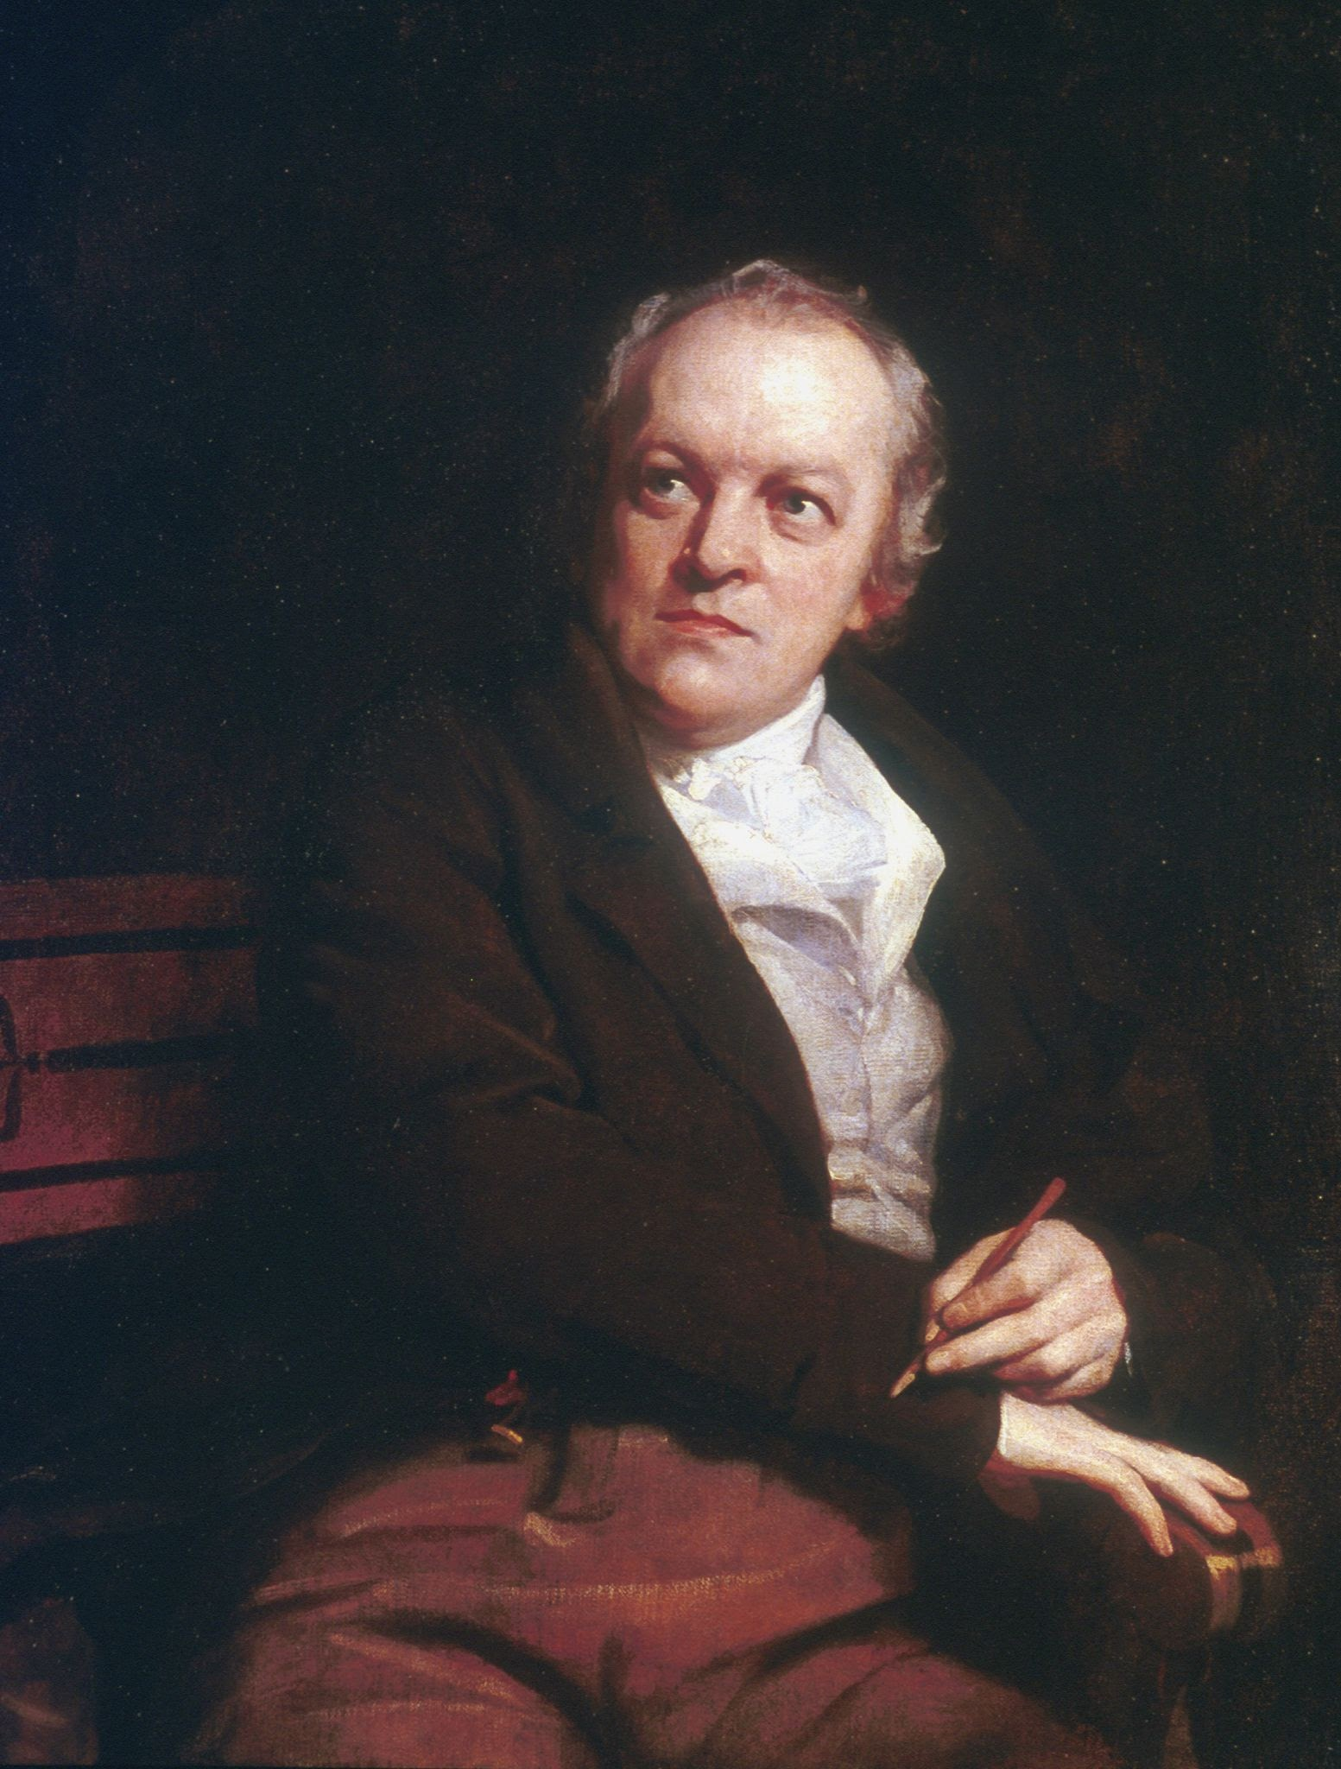
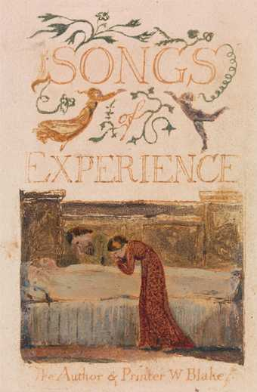
William Blake
Songs of Innocence and Experience

Slide 2
William Blake 1757-1827
Poet and artist (painter)
He has a symbolic, allusive style through which he veiled his radical religious, moral and political views in his poems.
Spiritual Life vs Corporeal Life
Antiquarianism «Britain can improve through the exploration of the lost past»
Religious and mythmaker (The Four Zoas)
«Poetical Sketches» he criticised neoclassical tradition.
«Illuminated printing» experimental style
Songs of Innocence and Experience ( Contrary states of the human soul)
The Book of Thel
The Marriage of Heaven and Hell
Jarusalem

Slide 3
Songs of Innocence and of Experience
«Two contrary states of the human soul»
1789-1794
«happy songs, Every child may joy to hear»
Injustice, evil, suffering
Poverty, disease, war, repression as representation of modern London
Infant Joy / Infant Sorrow
Lamb / Tyger

Slide 4
From Songs of Innocence
Introduction
Piping down the valleys wild -a
Piping songs of pleasant glee -b
On a cloud I saw a child.-a
And he laughing said to me. a
Pipe a song about a Lamb;
So I piped with merry chear,
Piper pipe that song again—
So I piped, he wept to hear.
Piper sit thee down and write
In a book that all may read—
So he vanish'd from my sight.
And I pluck'd a hollow reed.
And I made a rural pen, -a
And I stain'd the water clear,-b
And I wrote my happy songs-c
Every child may joy to hear-b

Slide 5
Tone: glee, happy,
Imagery: pastoral landscape, Edenic World, place of perfection, uncorrupted place
Pastoral elements evoking the traditional features of Eden (pipe, valleys, lamb, cloud,..)
Symbolism: Pipe, shepherd, child (naive, pure, innocent, close to nature)
Child and Lamb invoke the sense of both innocence and christian faith
Ideal state of the soul is represented by the persona, the child
Abab rhyme scheme presents the air of untroubled serenity
Hollow reed, rural pen: the process of artistic creation, divine inspiration
Water stained: innocence confronted with experience, corruption or a cahllange against the conventions in literary and social terms
At the end, this serenity is distorted with another rhyme scheme and the poet’s experience in his artistic creation

Slide 6
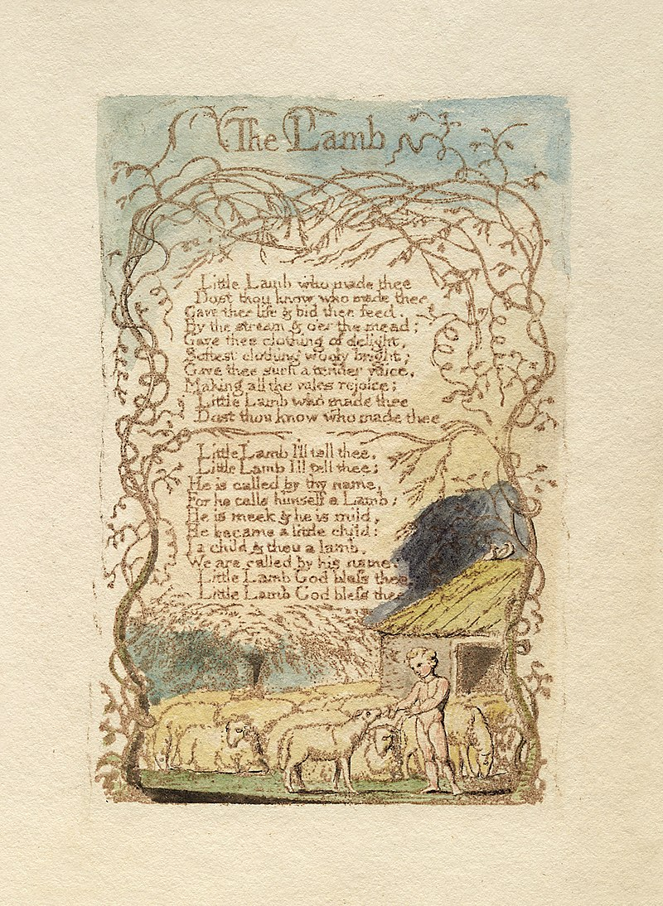
The Lamb
Little Lamb I'll tell thee,
Little Lamb I'll tell thee!
He is called by thy name,
For he calls himself a Lamb:
He is meek & he is mild,
He became a little child:
I a child & thou a lamb,
We are called by his name.
Little Lamb God bless thee.
Little Lamb God bless thee.
Little Lamb who made thee
Dost thou know who made thee
Gave thee life & bid thee feed.
By the stream & o'er the mead;
Gave thee clothing of delight,
Softest clothing wooly bright;
Gave thee such a tender voice,
Making all the vales rejoice!
Little Lamb who made thee
Dost thou know who made thee

Slide 7
Tone: Tender, soft, pleasent, childlike, and prayerlike (God bless thee)
The tone is embedded in a sense of wonder and awe, as the speaker contemplates the lamb's creation by a benevolent and loving God
This tone evokes a sense of intimacy between the speaker, the lamb, and the divine
It invites the reader to share in the speaker's sense of paying tribute and connection to the natural world and God.
Imagery:
Lamb evokes a sense of warmth, softness, and innocence. It is gentle and meek so it symbolizes purity and innocence.
Semantic field of nature: Lamb, vales, the stream, the mead, (natural landscape)
«softest clothing woolly bright»
Transition from physical World to spiritual World
Symbolism:
Lamb: innocence and Jesus Christ (sacrificial)
Lamb: ignorant, close to nature, vulnurable
Clothing: protection, warmth, bless, forgiveness
Anaphora: "Little Lamb, who made thee?" emphasizes the speaker's sense of wonder and awe at the lamb's existence,
It is a contemplation on the nature of creation and divine creation.
Personification of nature

Slide 8
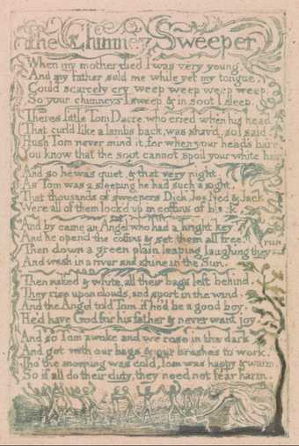
SONGS OF INNOCENCE: THE CHIMNEY SWEEPER
When my mother died I was very young,
And my father sold me while yet my tongue
Could scarcely cry ’ ‘weep! ‘weep! ‘weep! ‘weep!’
So your chimneys I sweep & in soot I sleep.
There’s little Tom Dacre, who cried when his head
That curled like a lamb’s back, was shaved, so I said,
‘Hush, Tom! never mind it, for when your head’s bare,
You know that the soot cannot spoil your white hair.’
And so he was quiet, & that very night,
As Tom was a-sleeping he had such a sight!
That thousands of sweepers, Dick, Joe, Ned, & Jack,
Were all of them locked up in coffins of black;
And by came an Angel who had a bright key,
And he opened the coffins & set them all free;
Then down a green plain, leaping, laughing they run,
And wash in a river and shine in the Sun.
Then naked & white, all their bags left behind,
They rise upon clouds, and sport in the wind.
And the Angel told Tom, if he’d be a good boy,
He’d have God for his father & never want joy.
And so Tom awoke; and we rose in the dark
And got with our bags & our brushes to work.
Though the morning was cold, Tom was happy & warm;
So if all do their duty, they need not fear harm.

Slide 9
SONGS OF EXPERIENCE
Hear the voice of the Bard!
Who Present, Past, & Future sees
Whose ears have heard,
The Holy Word,
That walk'd among the ancient trees.
Calling the lapsed Soul
And weeping in the evening dew:
That might controll,
The starry pole;
And fallen fallen light renew!
O Earth O Earth return!
Arise from out the dewy grass;
Night is worn,
And the morn
Rises from the slumberous mass.
Turn away no more:
Why wilt thou turn away
The starry floor
The watry shore
Is giv'n thee till the break of day.

Slide 10
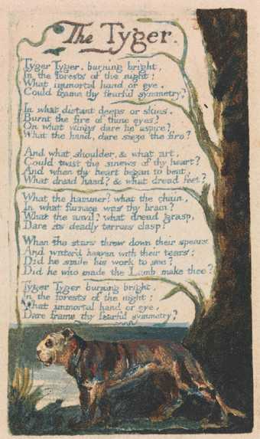
SONGS OF EXPERIENCE: THE TYGER
Tyger Tyger, burning bright,
In the forests of the night;
What immortal hand or eye,
Could frame thy fearful symmetry?
In what distant deeps or skies.
Burnt the fire of thine eyes?
On what wings dare he aspire?
What the hand, dare seize the fire?
And what shoulder, & what art,
Could twist the sinews of thy heart?
And when thy heart began to beat,
What dread hand? & what dread feet?
What the hammer? what the chain,
In what furnace was thy brain?
What the anvil? what dread grasp,
Dare its deadly terrors clasp!
When the stars threw down their spears
And water’d heaven with their tears:
Did he smile his work to see?
Did he who made the Lamb make thee?
Tyger Tyger burning bright,
In the forests of the night:
What immortal hand or eye,
Dare frame thy fearful symmetry?

Slide 11
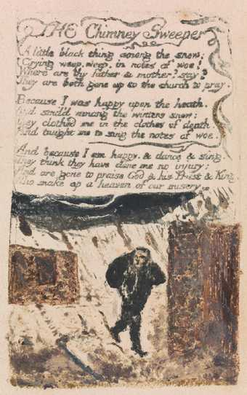
SONGS OF EXPERIENCE: THE CHIMNEY SWEEPER
A little black thing among the snow,
Crying ‘weep! ‘weep!’ in notes of woe!
‘Where are thy father and mother? say?’
‘They are both gone up to the church to pray.
Because I was happy upon the heath,
And smil’d among the winter’s snow,
They clothed me in the clothes of death,
And taught me to sing the notes of woe.
And because I am happy and dance and sing,
They think they have done me no injury,
And are gone to praise God and his Priest and King,
Who make up a heaven of our misery.’

Slide 12
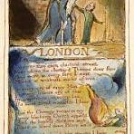
LONDON
I wander thro' each charter'd street,
Near where the charter'd Thames does flow.
And mark in every face I meet
Marks of weakness, marks of woe.
In every cry of every Man,
In every Infants cry of fear,
In every voice: in every ban,
The mind-forg'd manacles I hear
How the Chimney-sweepers cry
Every blackning Church appalls,
And the hapless Soldiers sigh
Runs in blood down Palace walls
But most thro' midnight streets I hear
How the youthful Harlots curse
Blasts the new-born Infants tear
And blights with plagues the Marriage hearse

